Slide 1
Tortuosity
A web based quiz for Geology students.
John Rugen, Louis, Gareth and Mohammed.

Slide 2
Recap
Tortuosity is a web app designed for Geology students participating in a quiz. Our client would like to host a quiz within her lessons and asked us to build a blockbusters type game.
The teacher would pull up the gameboard on her computer for the whole class to see.
The students then connect to the game, and once the teacher selects a question it gets pushed to the students phone. They can answer it from there.
It’s a knockout quiz, if you get a question wrong you are locked out from the session.

Slide 3
A Change In Direction
The tortuosity project began with Phaser in mind for the gameplay.
This got thrown out the window relatively early in development due to compatibility issues with connectivity.
Tortuosity now uses HTML, JavaScript, jQuery and Firebase.

Slide 4
What’s new?
The project has come a long way since the last presentation.
The game can be accessed by anyone with an android phone and an internet connection. It is fully playable and makes use of real time databases.
There are 12 questions that our client gave to us. We’ve included multiple choices for testing purposes as Geology isn’t everyone's strong suit.

Slide 5
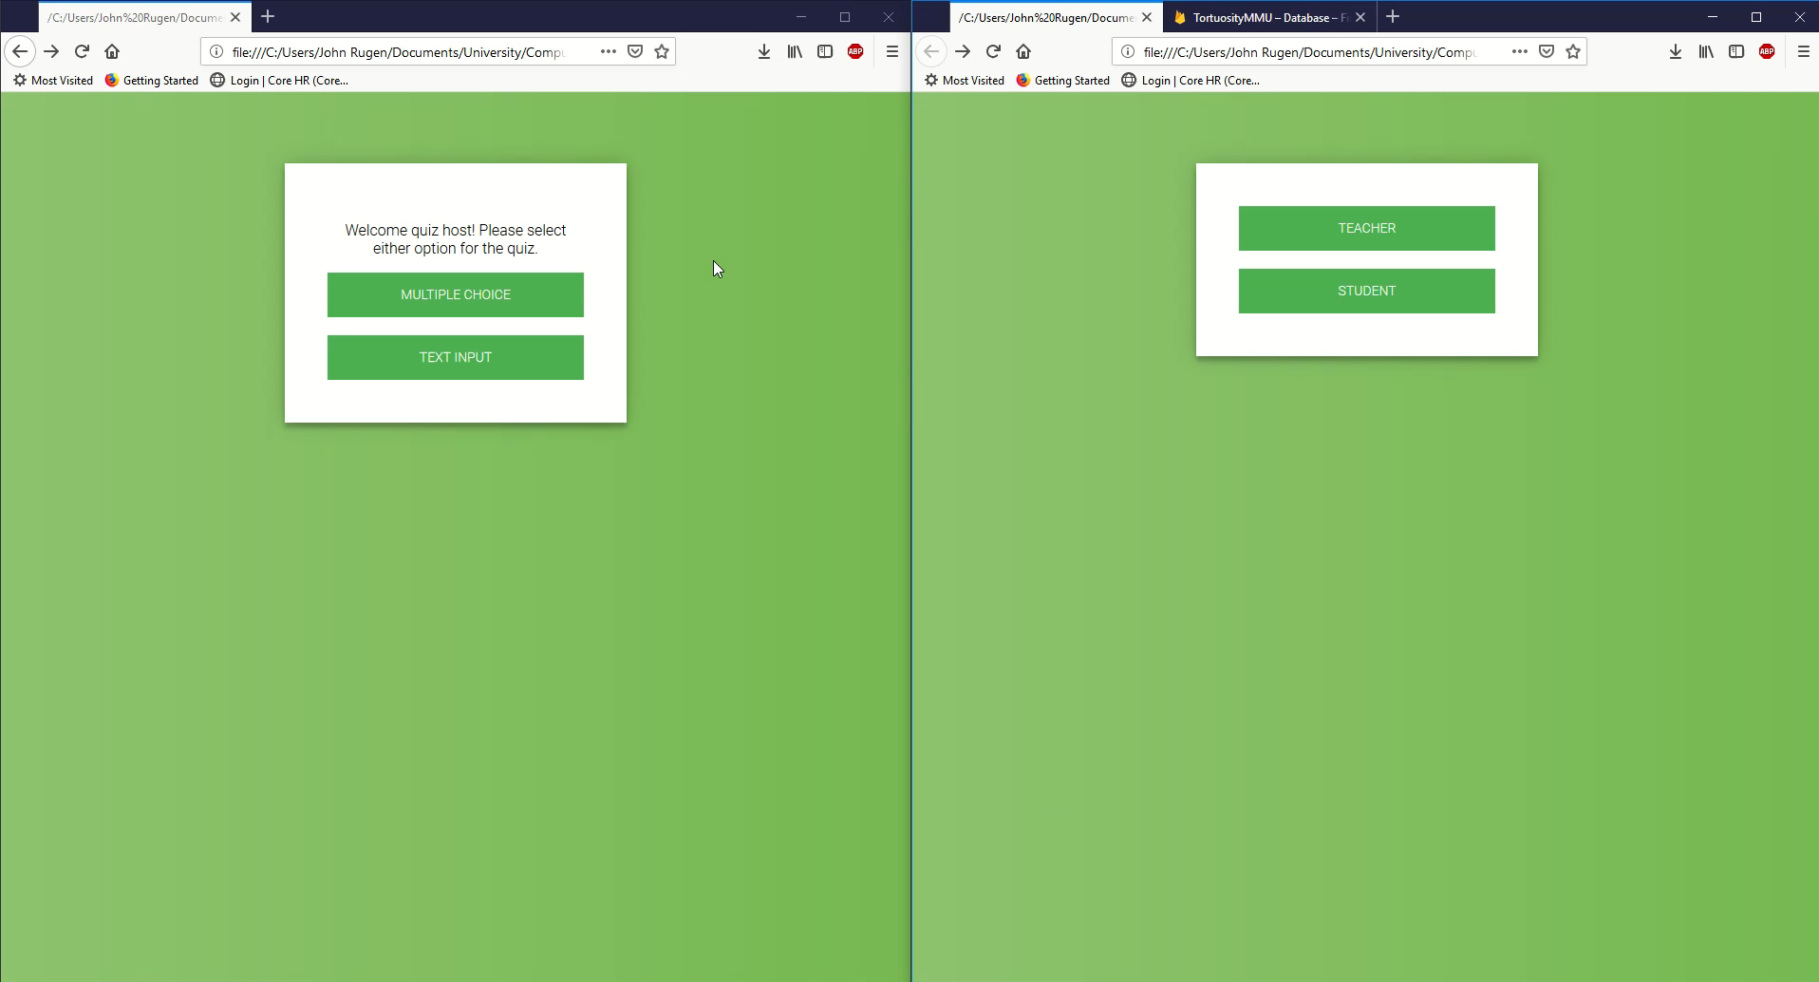
Gameplay

Slide 6
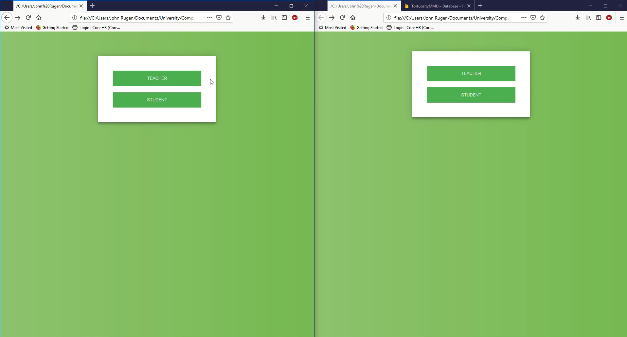
Multiple Choice

Slide 7
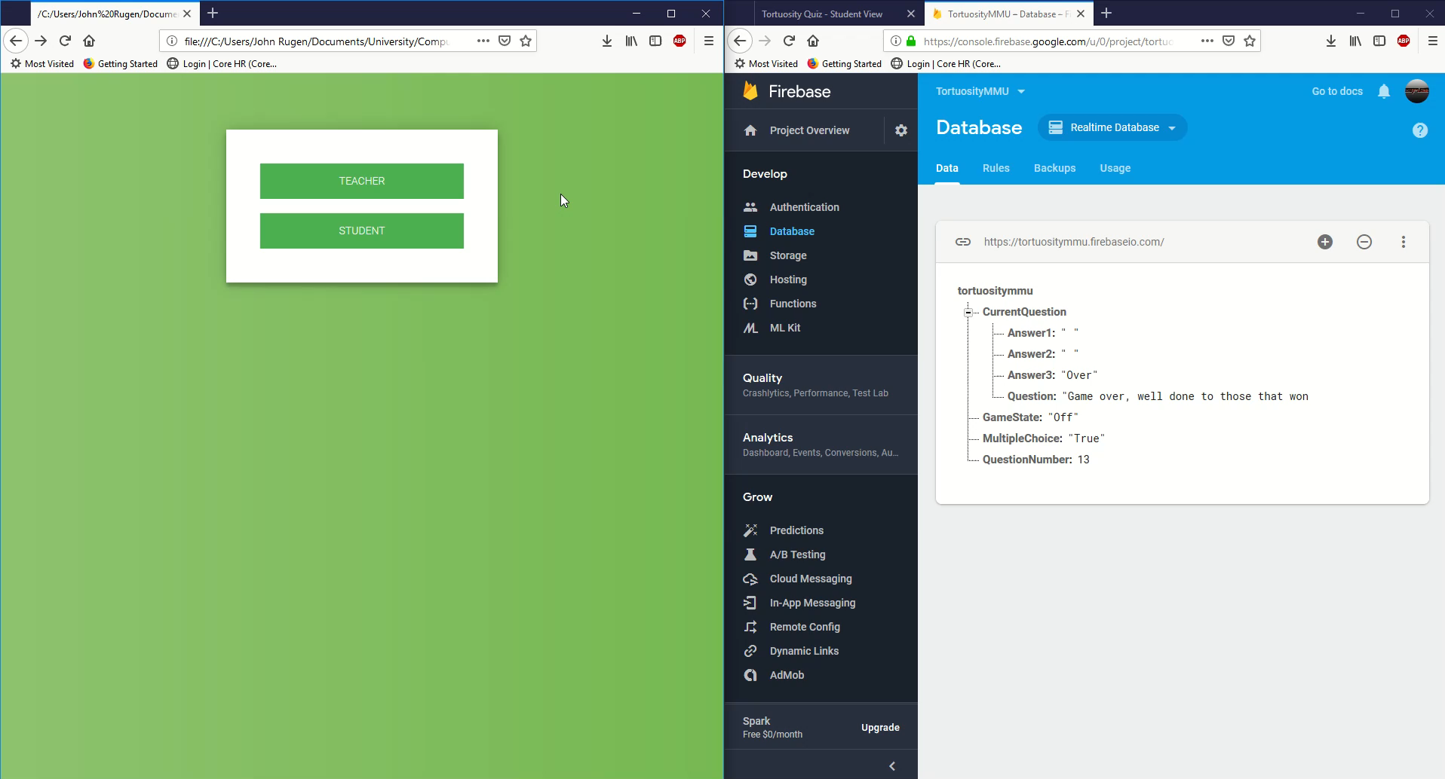
Database updating in Realtime

Slide 8
What’s Next?
Synchronising gameplay between devices was the hardest part of this project so far. With that out the way, design is our next objective.
Creating a simple yet sleek interface for students to interact with is our next task.
Creating a program for the Teacher to change the questions without any programming knowledge is a priority too.
Working within VR to make this game intriguing to everyone, not just Geology students.
Adding single player so that students can practice and use as simple revision aid.

Slide 9
https://tortuositymmu.firebaseapp.com/

